Slide 1
E VOTING SYSTEM
BECAUSE EVERY VOTE COUNTS

Slide 2
Group Members
Samarth Vijayvargiya (0827IT151098)
Shivam Yadav (0827IT151104)
Siddharth Jain (0827IT151111)
Virendra Yadav (0827IT151119)
Vivek soni (0827IT151120)

Slide 3
Contents:-
• Abstract
• Problem definition
• Introduction to Solution
• Project Objectives
• Survey Reports
• Survey Analysis
• Solution Proposal
• Project Description
Diagram
• Expected Outcome
• Technical Details
• Conclusion
• Limitations

Slide 4
Abstract
The voting system used for elections in college or university elections is ballot paper system which is highly unreliable .In this method ,voter has to go to the polling booth for casting his vote due to which many students who are not present in country due to some reason cannot cast their votes . The whole process is time consuming. The proposed system seeks to address above issues.

Slide 5
Problem definition
The people who are outside the city cannot vote
The people who are disabled has to face problems to cast their vote
People tend to give false votes either by trickery or intimidating the booth volunteers.

Slide 6
Introduction to Solution
It deals with Online Polling which facilitates the public to vote on the internet rather than going to the polling booths. The principal users of this system are the Citizens. After login the voters can get the information about any candidate by viewing their profile. But first they have to register themselves. Voter can cast his vote only once in an election by tracking the details of all those voters who have already voted. The system will control the function of gathering the information from the user and it will be stored into the database. Voters are able to view the results.

Slide 7
Project Objectives
Registration of citizen with Aadhaar number.
Secure authentication facility to check & validate citizen logging to the voting system.
Create database to store data of registered citizen.
Enable voter to cast vote to desired candidate only once.
Immediate calculation of votes.
Enable voter to view profile of candidates.

Slide 8
Project Description
This project mainly focuses on voting which will be done by the citizens of the country and here voting will be done online to reduce human effort as well as providing additional advantages so that voting can be done easily and safely. The record of the voter will be stored in the database and hence a user can only vote once to a particular candidate. The user can also view the profile of the candidate to whom he/she will vote. Once done the user will simply have to logout of the website.

Slide 9
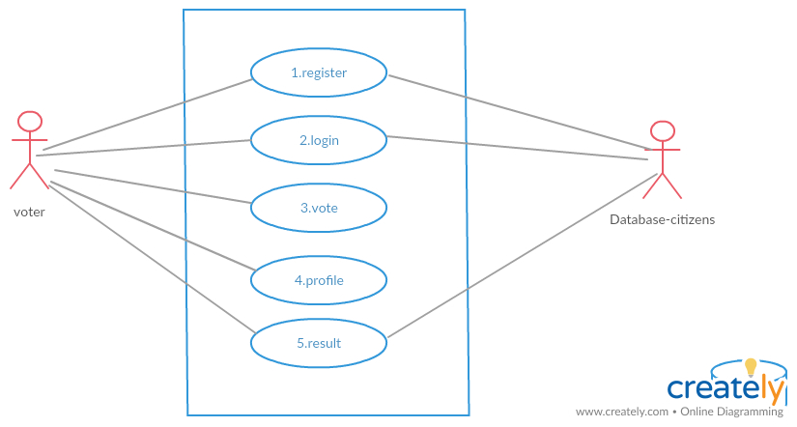
Diagrams – UML Diagram

Slide 10
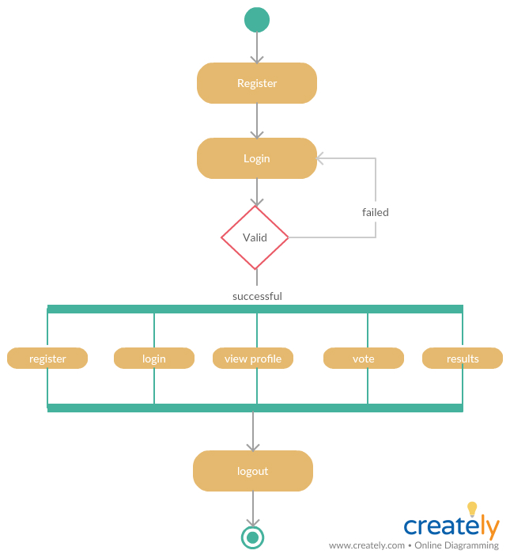
Activity Diagram

Slide 11
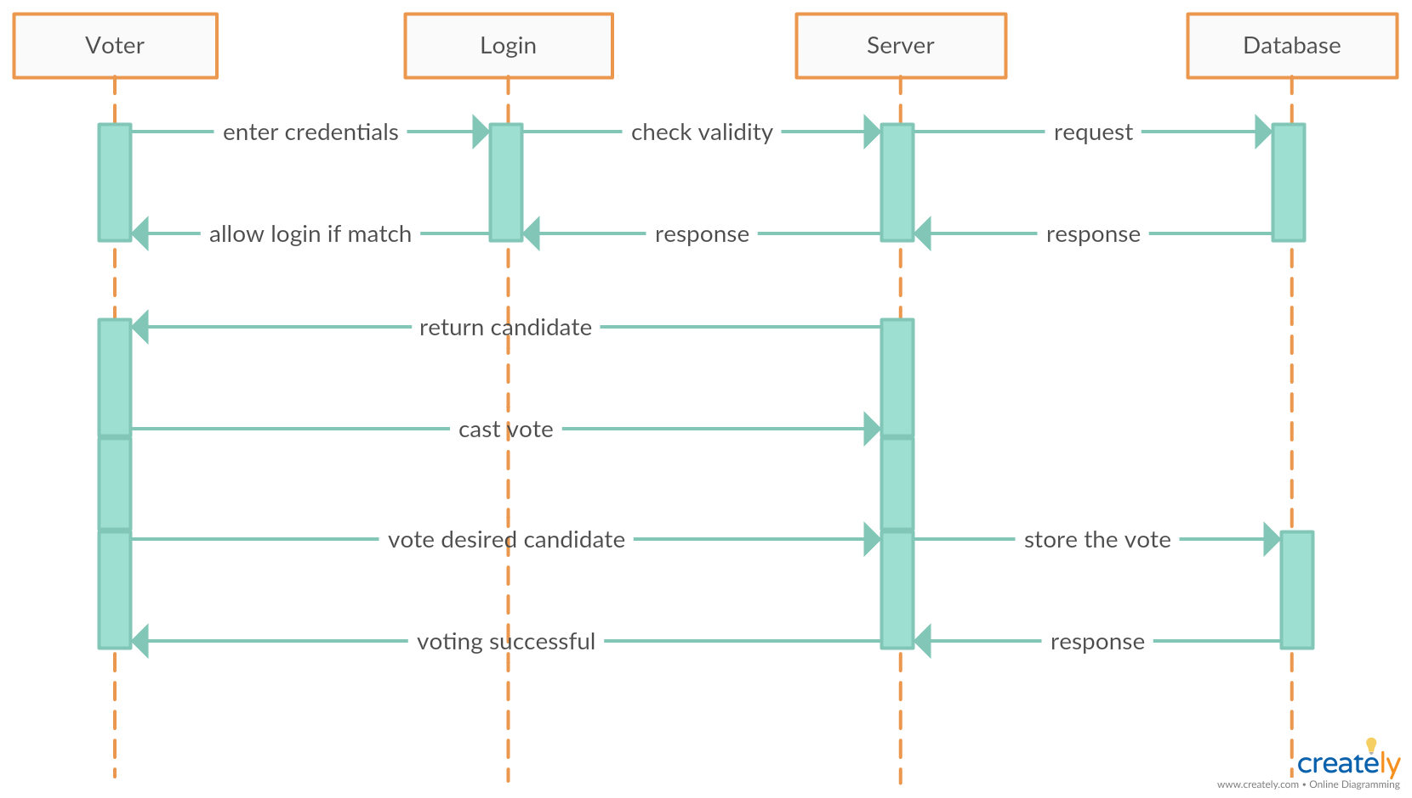
Sequance Diagram

Slide 12
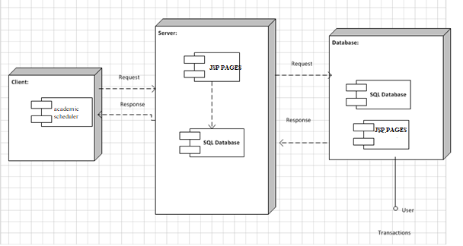
Deployment Diagram
Deployment Diagram

Slide 13
Expected Outcome
The outcome of the project will be to provide better way to vote which will be safe and fully secure without any case of fraud.

Slide 14
Technical Details
Technology used in this project will be
Front End
HTML
JAVA
CSS
Back End
My SQL
Software Requirement
Apache Tomcat
Eclipse
Operating System
Window 7/8/10

Slide 15
Conclusion
This Online Voting system will manage the Voter’s information by which voter can login and use his voting rights. The system will incorporate all features of voting system. It provides the tools for maintaining voter’s vote to every candidate and it count total no. of votes of every candidate. There is a database which is maintained in which all the names of voter with complete information are stored.
In this user who has a valid adhaar no can register his/her information in the database and when he/she want to vote he/she has to login by his adhaar and password and can vote to any candidate only single time. Voting detail is stored in database and the result is displayed by calculation. By online voting system percentage of voting can increase. It decreases the cost and time of voting process. It is very easy to use and it is very less time consuming.

Slide 16
Thank you

